Slide 1
Application Layer Protocols
Unit 5

Slide 2
Application Layer
The application layer is present at the top of the OSI model.
It is the layer through which users interact. It provides services to the user.
Focus on process-to-process communication across an IP network and provides a firm communication interface and end-user services.
Provides full end-user access to a variety of shared network services for efficient OSI model data flow.

Slide 3
Application Layer
The application layer provides many services, including:
Simple Mail Transfer Protocol
File transfer
Web surfing
Web chat
Email clients
Network data sharing
Various file and data operations
This layer has different responsibilities, including error handling and recovery, data flow over a network and full network flow.
It is also used to develop network-based applications.

Slide 4
Application Layer
It defines how an application's processes (clients and servers), running on different end systems, pass messages to each other.
An application layer protocol defines:
The types of messages exchanged, e.g. request messages and response messages.
The syntax of the various message types, i.e. the fields in the message and how the fields are defined.
The semantics of the fields, i.e. the meaning of the information in the fields.
Rules for determining when and how a process sends messages and responds to messages.

Slide 5
DHCP
Dynamic Host Configuration Protocol (DHCP) is a network management protocol used to dynamically assign an IP address to different device, or node, on a network so they can communicate using IP (Internet Protocol).
DHCP automates and centrally manages these configurations.
There is no need to manually assign IP addresses to new devices.
Therefore, there is no requirement for any user configuration to connect to a DHCP based network.

Slide 6
DHCP
Dynamic Host Configuration Protocol(DHCP) is an application layer protocol which is used to provide:
Subnet Mask (255.255.255.0)
Router Address (192.168.1.1)
DNS Address (8.8.8.8)
Vendor Class Identifier
DHCP is based on a client-server model and based on discovery, offer, request, and ACK.

Slide 7
DHCP Working
DHCP runs at the application layer of the TCP/IP stack to dynamically assign IP addresses to DHCP clients and to allocate TCP/IP configuration information to DHCP clients.
This includes subnet mask information, default gateway IP addresses and domain name system (DNS) addresses.
DHCP is a client-server protocol in which servers manage a pool of unique IP addresses, as well as information about client configuration parameters.

Slide 8
DHCP Components
DHCP Server: DHCP server is a networked device running the DCHP service that holds IP addresses and related configuration information. This is typically a server or a router but could be anything that acts as a host, such as an SD-WAN appliance.
DHCP client: DHCP client is the endpoint that receives configuration information from a DHCP server. This can be any device like computer, laptop, IoT endpoint or anything else that requires connectivity to the network. Most of the devices are configured to receive DHCP information by default.
IP address pool: IP address pool is the range of addresses that are available to DHCP clients. IP addresses are typically handed out sequentially from lowest to the highest.

Slide 9
DHCP Components
Subnet: Subnet is the partitioned segments of the IP networks. Subnet is used to keep networks manageable.
Lease: Lease is the length of time for which a DHCP client holds the IP address information. When a lease expires, the client has to renew it.
DHCP relay: A host or router that listens for client messages being broadcast on that network and then forwards them to a configured server. The server then sends responses back to the relay agent that passes them along to the client. DHCP relay can be used to centralize DHCP servers instead of having a server on each subnet.

Slide 10
Benefits of DHCP
Centralized administration of IP configuration: DHCP IP configuration information can be stored in a single location and enables that administrator to centrally manage all IP address configuration information.
Dynamic host configuration: DHCP automates the host configuration process and eliminates the need to manually configure individual host. When TCP/IP is first deployed or when IP infrastructure changes are required.
Seamless IP host configuration: The use of DHCP ensures that DHCP clients get accurate and timely IP configuration IP configuration parameter such as IP address, subnet mask, default gateway, IP address of DND server and so on without user intervention.
Flexibility and scalability: Using DHCP gives the administrator increased flexibility, allowing the administrator to move easily change IP configuration when the infrastructure changes.

Slide 11
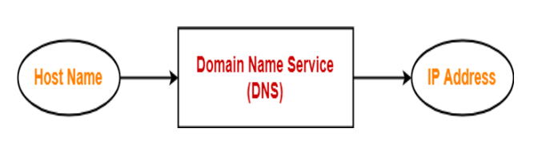
DNS
DNS in Networking
DNS is short for Domain Name Service or Domain Name System.
It is an application layer protocol.
Purpose:
DNS is a host name to IP Address translation service.
It converts the names we type in our web browser address bar to the IP Address of web servers hosting those sites

Slide 12
DNS
Domain Name Service (DNS) The need for Domain Name Service arises due to the following reasons-
IP Addresses are not static and may change dynamically.
So, a mapping is required which maps the domain names to the IP Addresses of their web servers.
IP Addresses are a complex series of numbers. So, it is difficult to remember IP Addresses directly while it is easy to remember names.
DNS uses UDP (port 53) at the transport layer.

Slide 13
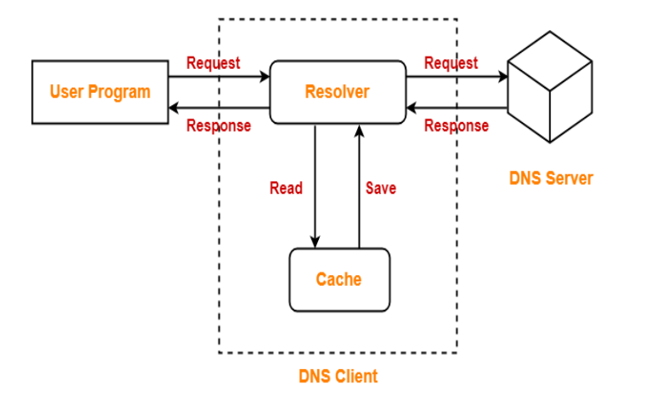
Resolution process
DNS Resolution is a process of resolving a domain name onto an IP Address.

Slide 14
Resolution process
The steps involved in DNS Resolution are-
Step-01:
A user program sends a name query to a library procedure called the resolver.
Step-02:
Resolver looks up the local domain name cache for a match. If a match is found, it sends the corresponding IP Address back.
If no match is found, it sends a query to the local DNS server.
Step-03:
DNS server looks up the name.
If a match is found, it returns the corresponding IP Address to the resolver.
If no match is found, the local DNS server sends a query to a higher level DNS server.
This process is continued until a result is returned.
Step-04:
After receiving a response, the DNS client returns the resolution result to the application

Slide 15
Resolution process
DNS is a connection less protocol.
DNS uses UDP at the transport layer for replying to the DNS queries of clients.
Therefore, it is a connection less protocol.
DNS is non-persistent.
DNS is a stateless protocol.
DNS server accepts the requests, process them, resolves the query and forget about them.
It does not make any assumption how long this will be.
Mapping an IP Address onto a domain name is referred to as Inverse domain.
DNS can translate a domain name onto an IP Address.
Also, it can translate an IP Address onto a domain name.

Slide 16
Resolution process
For the first time, there is more delay in translating the domain name onto an IP Address.
Converting a domain name onto an IP Address is an extra overhead.
This overhead is called as DNS Overhead.
It causes an unnecessary delay in serving the request.
So, there is more delay for the first time.
To reduce the delay next time, IP Addresses are stored in the computer using log.
This avoids the DNS overhead next time and takes less time in serving the request.
When it gets expired, the request is again served through DNS.

Slide 17
DNS protocol structure
DNS is a service that translates the domain name into IP addresses.
This allows the users of networks to utilize user-friendly names when looking for other hosts instead of remembering the IP addresses.
Ex: Suppose the site of Yashaswi’s(IIMS) had an IP address of 132.147.165.50,
most people would reach this site by specifying http://yashaswi.edu.in/
Therefore, the domain name is more reliable than IP address.

Slide 18
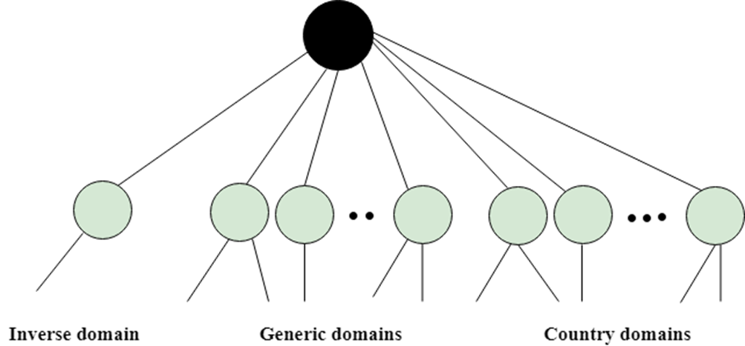
DNS protocol structure
DNS is a TCP/IP protocol used on different platforms. The domain name space is divided into three different sections: Generic domains, Country domains, and Inverse domain.

Slide 19
Generic Domains
It defines the registered hosts according to their generic behavior.
Each node in a tree defines the domain name, which is an index to the DNS database.
It uses three-character labels, and these labels describe the organization type.

Slide 20
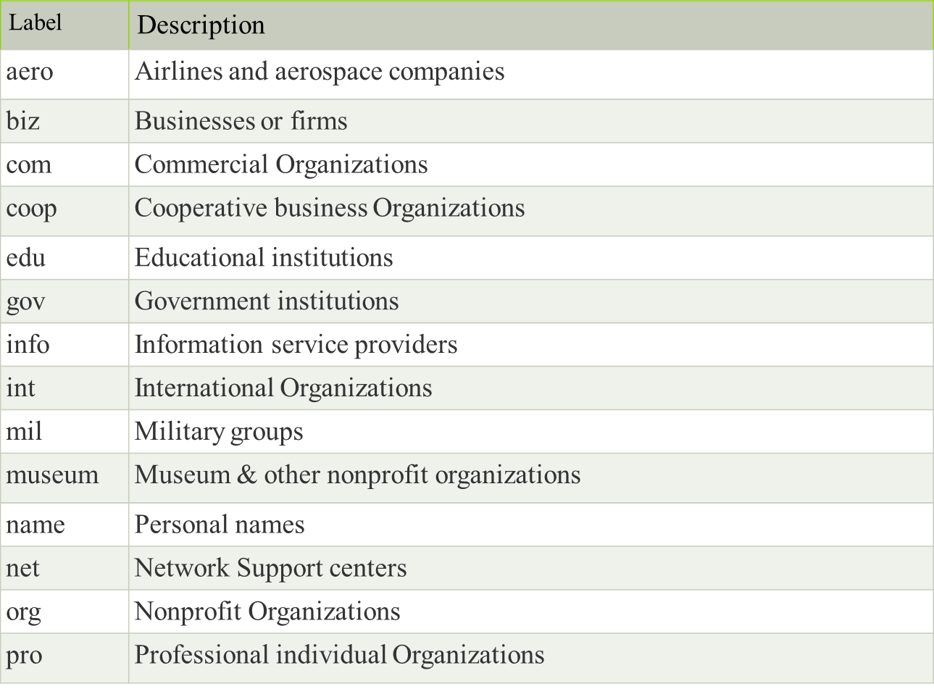
Generic Domains

Slide 21
Domain Name System (DNS)
Country Domain
The format of country domain is same as a generic domain, but it uses two-character country abbreviations (e.g. in for India, us for the United States) in place of three character organizational abbreviations.
Inverse Domain
The inverse domain is used for mapping an address to a name. When the server has received a request from the client, and the server contains the files of only authorized clients. To determine whether the client is on the authorized list or not, it sends a query to the DNS server and ask for mapping an address to the name.

Slide 22
Working of DNS
DNS is a client/server network communication protocol. DNS clients send requests to the server while DNS servers send responses to the client.
Client requests contain a name which is converted into an IP address known as a forward DNS lookups while requests containing an IP address which is converted into a name known as reverse DNS lookups.
DNS implements a distributed database to store the name of all the hosts available on the internet.
If a client like a web browser sends a request containing a hostname, then a piece of software such as DNS resolver sends a request to the DNS server to obtain the IP address of a hostname.
If DNS server does not contain the IP address associated with a hostname, then it forwards the request to another DNS server. If IP address has arrived at the resolver, which in turn completes the request over the internet protocol.

Slide 23
DNS Resource records
DNS records are used to specify various types of information about a domain, such as its IP address, the servers that handle its email, and other related information.
These records are stored in a DNS database, which is a distributed database that is used to translate human-readable domain names into IP addresses that computers can understand.
There are several different types of DNS records, including A records, MX records, CNAME records etc. each with its own specific purpose.
A record maps a domain or subdomain to an IP address. Ex: the domain “abc.com" might have an A record that maps it to the IP address "192.0.2.1". When someone types “abc.com" into their web browser, the browser will use the A record to find the corresponding IP address and connect to the server at that location.
MX records (mail exchange records) are used to route email for a domain to the correct email server. Each MX record specifies a hostname and a priority value. The hostname is the domain name of the server that should handle email for the domain, and the priority value is used to specify which server should be used first if there are multiple servers available.
CNAME records (Canonical Name Records) are used to create aliases for domains. Ex: if you have a domain "abc.com" that points to a server at "192.0.2.1" and you want to create an alias "www.abc.com" that points to the same server, you can use a CNAME record to do this.

Slide 24
DNS Resource records
Other different types of DNS records are:
TXT record (Text Record) − stores arbitrary text in a domain's DNS record.
PTR record (Pointer Record) − maps an IP address to a domain name.
NS record (Name Server Record) − specifies the name servers for a domain.
SOA record (Start of Authority Record) − specifies the DNS server that is the authority for a specific domain.
SRV record (Service Record) − specifies the hostname and port number for a specific service, such as a website or email server.

Slide 25
HTTP
HTTP stands for Hypertext Transfer Protocol.
It is a protocol used to access the data on the World Wide Web (www).
The HTTP protocol can be used to transfer the data in the form of plain text, hypertext, audio, video, and so on.
This protocol is known as Hypertext Transfer Protocol because of its efficiency that allows us to use in a hypertext environment where there are rapid jumps from one document to another document.
HTTP is similar to the FTP as it also transfers the files from one host to another host.
HTTP is simpler than FTP as HTTP uses only one connection, i.e. no control connection to transfer the files.
HTTP is used to carry the data in the form of MIME-like format.
HTTP is similar to SMTP as the data is transferred between client and server.
The HTTP differs from the SMTP in the way the messages are sent from the client to the server and from server to the client. SMTP messages are stored and forwarded while HTTP messages are delivered immediately.

Slide 26
HTTP
Features of HTTP:
Connectionless protocol: HTTP is a connectionless protocol. HTTP client initiates a request and waits for a response from the server. When the server receives the request, the server processes the request and sends back the response to the HTTP client after which the client disconnects the connection. The connection between client and server exist only during the current request and response time only.
Media independent: HTTP protocol is a media independent as data can be sent as long as both the client and server know how to handle the data content. It is required for both the client and server to specify the content type in MIME-type header.
Stateless: HTTP is a stateless protocol as both the client and server know each other only during the current request. Due to this nature of the protocol, both the client and server do not retain the information between various requests of the web pages.

Slide 27
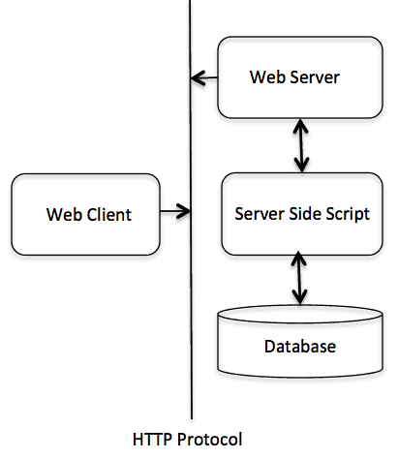
HTTP: Request and Response Message

Slide 28
HTTP: Request and Response Message
The HTTP protocol is a request/response protocol based on the client/server based architecture where web browsers, robots and search engines, etc. act like HTTP clients, and the Web server acts as a server.
Request Message: An HTTP request is ways that web browsers ask for information to load website pages. HTTP request contains HTTP version type, a URL, HTTP request headers and HTTP body.
HTTP request headers: HTTP request headers include text information saved in key-value pairs, and these contained in every HTTP request.
URL: A client that wants to access a document needs an address. To facilitate the access of documents distributed throughout the world, HTTP protocol uses the concept of locations. The World Wide Web uses a locator called a URL to identify and intertribal data.
URL called as (Uniform Resource Locator). A URL is an internet address of any website in common format https://www.iims.ac.in/.
A URL has three parts: Method: //Host/Path, which used for accessing any file, document or website.

Slide 29
HTTP: Request and Response Message
Response Message: The response message is sent by the server to the client.
An HTTP response means when the web client gets the answer back from the webserver. It contains the information that asked for in the HTTP request. The HTTP response includes an HTTP status code, HTTP response headers, and an HTTP body.
HTTP status codes: Often, when a client sends a request to the server, and If the HTTP request is not correct, the error comes. These errors shown in numeric codes. These also called HTTP status codes. The server gives these status codes to identify the problem.
Some standard codes are shown below.
401-“Unauthorized.”
400-“Bad request.”
404-“File not found.”

Slide 30
Working of the HTTP Protocol
Step 1: Establishing a TCP/IP connection by the client.
The first step is initiating a TCP connection with the server by the client. Once the connection established, the browser and the server access TCP through their socket interfaces.
Step 2: Initiating an HTTP GET request to the server by the client.
The http request first line of the message is called the request line. The lines below the request line are known as header lines.
The request line has three fields- method, URL, and version.
Method field can take several values like GET, POST, HEAD, PUT and DELETE, etc. The GET method used when the browser requests an object, with the requested object identified in the URL field.
GET: It retrieves those documents which identified in the URL.
POST: It will give information to the server.
HEAD: It retrieves the meta-information about the document identified in the URL.
PUT: It stores those documents which are under specified URL.
DELETE: It deletes the specified URL.
TRACE: It will loop back the request message.
Step 3: HTTP Server Response to an HTTP GET request.
HTTP response message has three sections- status line, header lines, and an entity-body. Further, the status line has 3 fields- version, status code, and phrase. After then, header lines are there. In the end, there is the entity-body, which contains the requested message itself.

Slide 31
Email Protocols – SMTP
SMTP stands for Simple Mail Transfer Protocol.
SMTP is a set of communication guidelines that allow software to transmit an electronic mail over the internet is called Simple Mail Transfer Protocol.
It is a program used for sending messages to other computer users based on e-mail addresses.
It provides a mail exchange between users on the same or different computers, and it also supports:
It can send a single message to one or more recipients.
Sending message can include text, voice, video or graphics.
It can also send the messages on networks outside the internet.
The main purpose of SMTP is used to set up communication rules between servers.
The servers have a way of identifying themselves and announcing what kind of communication they are trying to perform.
They also have a way of handling the errors such as incorrect email address. Ex: if the recipient address is wrong, then receiving server reply with an error message of some kind.

Slide 32
Email Protocols – SMTP
The SMTP model is of two types:
End-to-end method
Store-and- forward method
The end-to-end model is used to communicate between different organizations whereas the store and forward method is used within an organization.
An SMTP client who wants to send the mail will contact the destination’s host SMTP directly, in order to send the mail to the destination.
The SMTP server will keep the mail to itself until it is successfully copied to the receiver’s SMTP.
The client SMTP is the one that initiates the session so let us call it client- SMTP and the server SMTP is the one that responds to the session request so let us call it receiver-SMTP. The client- SMTP will start the session and the receiver-SMTP will respond to the request.

Slide 33
Email Protocols – SMTP
An SMTP client who wants to send the mail will contact the destination’s host SMTP directly, in order to send the mail to the destination.
The SMTP server will keep the mail to itself until it is successfully copied to the receiver’s SMTP.
The client SMTP is the one that initiates the session so let us call it client- SMTP and the server SMTP is the one that responds to the session request so let us call it receiver-SMTP.
The client- SMTP will start the session and the receiver-SMTP will respond to the request.

Slide 34
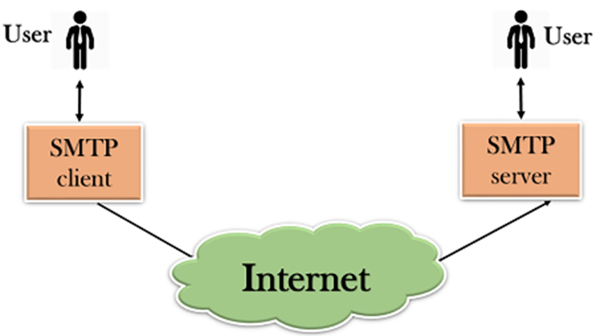
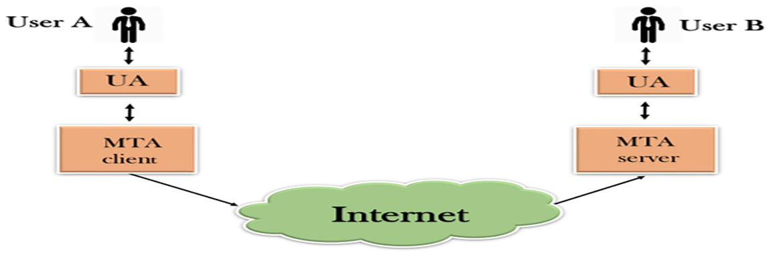
Components of SMTP
First, we will break the SMTP client and SMTP server into two components such as user agent (UA) and mail transfer agent (MTA).
The user agent (UA) prepares the message, creates the envelope and then puts the message in the envelope.
The mail transfer agent (MTA) transfers this mail across the internet.

Slide 35
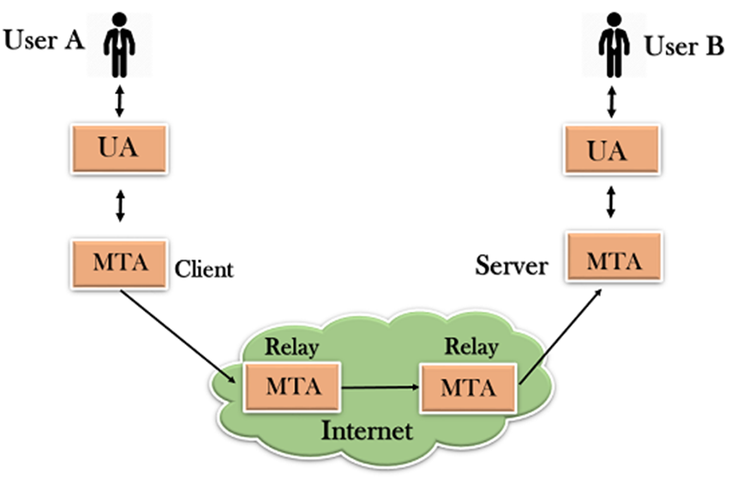
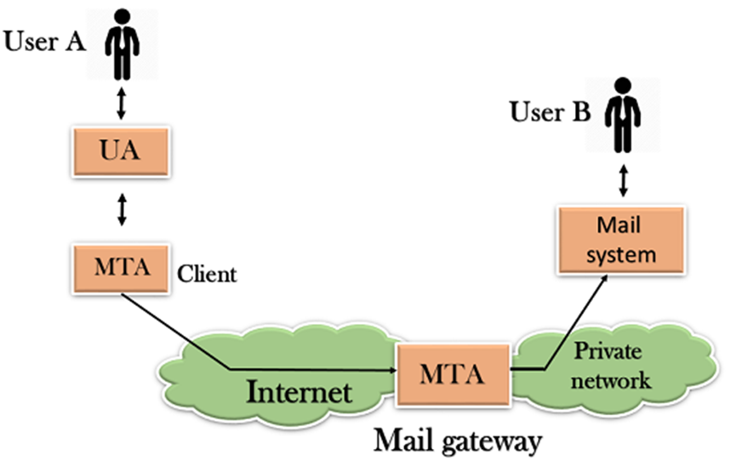
Components of SMTP
The relaying system without TCP/IP protocol can also be used to send the emails to users, and this is achieved by the use of the mail gateway. The mail gateway is a relay MTA that can be used to receive an email.
The relaying system without TCP/IP protocol can also be used to send the emails to users, and this is achieved by the use of the mail gateway. The mail gateway is a relay MTA that can be used to receive an email.

Slide 36
Working of SMTP
Composition of Mail: A user sends an e-mail by composing an electronic mail message using a Mail User Agent (MUA).
Mail User Agent is a program which is used to send and receive mail.
The message contains two parts: body and header.
The body is the main part of the message while the header includes information such as the sender and recipient address.
The header also includes descriptive information such as the subject of the message.
In this case, the message body is like a letter and header is like an envelope that contains the recipient's address.

Slide 37
Working of SMTP
Submission of Mail: After composing an email, the mail client then submits the completed e-mail to the SMTP server by using SMTP on TCP port 25.
Delivery of Mail: E-mail addresses contain two parts: username of the recipient and domain name. For example, vivek@gmail.com, where "vivek" is the username of the recipient and "gmail.com" is the domain name.
Receipt and Processing of Mail: Once the incoming message is received, the exchange server delivers it to the incoming server (Mail Delivery Agent) which stores the e-mail where it waits for the user to retrieve it.
Access and Retrieval of Mail: The stored email in MDA can be retrieved by using MUA (Mail User Agent). MUA can be accessed by using login and password.

Slide 38
Email Protocols - POP3
The POP protocol stands for Post Office Protocol.
SMTP is used as a message transfer agent. When the message is sent, then SMPT is used to deliver the message from the client to the server and then to the recipient server.
The message is sent from the recipient server to the actual server with the help of the Message Access Agent.
The Message Access Agent contains two types of protocols, i.e., POP3 and IMAP.

Slide 39
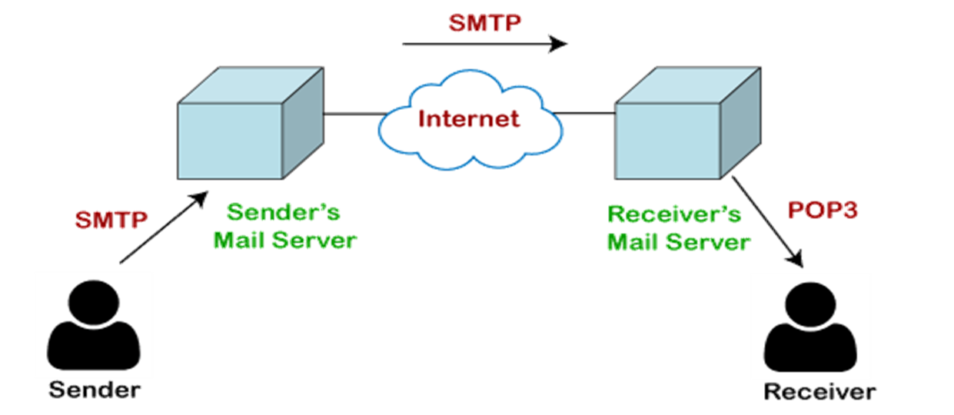
Email Protocols - POP3
How is mail transmitted?
Suppose sender wants to send the mail to receiver. First mail is transmitted to the sender's mail server.
Then, the mail is transmitted from the sender's mail server to the receiver's mail server over the internet.
On receiving the mail at the receiver's mail server, the mail is then sent to the user.

Slide 40
Email Protocols - POP3
The whole process is done with the help of Email protocols. The transmission of mail from the sender to the sender's mail server and then to the receiver's mail server is done with the help of the SMTP protocol.
At the receiver's mail server, the POP or IMAP protocol takes the data and transmits to the actual user.

Slide 41
Advantages of POP3 protocol
It provides easy and fast access to the emails as they are already stored on our PC.
There is no limit on the size of the email which we receive or send.
It requires less server storage space as all the mails are stored on the local machine.
It is a simple protocol so it is one of the most popular protocols used today.
It is easy to configure and use.

Slide 42
Disadvantages of POP3 protocol
If the emails are downloaded from the server, then all the mails are deleted from the server by default.
Transferring the mail folder from the local machine to another machine can be difficult.
Since all the attachments are stored on your local machine, there is a high risk of a virus attack if the virus scanner does not scan them. The virus attack can harm the computer.
The email folder which is downloaded from the mail server can also become corrupted.
The mails are stored on the local machine, so anyone who sits on your machine can access the email folder.

Slide 43
Email Protocols - IMAP4
IMAP stands for Internet Message Access Protocol. It is an application layer protocol which is used to receive the emails from the mail server. It is the most commonly used protocols like POP3 for retrieving the emails.
It also follows the client/server model. On one side, we have an IMAP client, which is a process running on a computer. On the other side, we have an IMAP server, which is also a process running on another computer. Both computers are connected through a network.

Slide 44
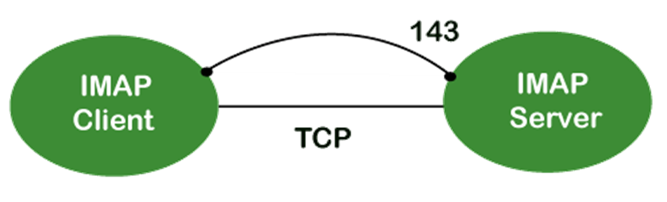
Email Protocols - IMAP4
The IMAP protocol resides on the TCP/IP transport layer which means that it implicitly uses the reliability of the protocol. Once the TCP connection is established between the IMAP client and IMAP server, the IMAP server listens to the port 143 by default, but this port number can also be changed.
By default, there are two ports used by IMAP:
Port 143: It is a non-encrypted IMAP port.
Port 993: This port is used when IMAP client wants to connect through IMAP securely.

Slide 45
Email Protocols - MIME
MIME stands for Multipurpose Internet Mail Extensions. It is used to extend the capabilities of Internet e-mail protocols such as SMTP.
The MIME protocol allows the users to exchange various types of digital content such as pictures, audio, video, and various types of documents and files in the e-mail.
MIME was created in 1991 by a computer scientist named Nathan Borenstein at a company called Bell Communications.

Slide 46
Email Protocols - MIME
MIME is an e-mail extension protocol, i.e., it does not operate independently, but it helps to extend the capabilities of e-mail in collaboration with other protocols such as SMTP.
MIME was able to transfer only text written file in a limited size English language with the help of the internet.
It is used by almost all e-mail related service companies such as Gmail, Yahoo-mail, Hotmail.

Slide 47
Email Protocols - MIME
Need of MIME Protocol
The MIME protocol supports multiple languages in e-mail, such as Hindi, French, Japanese, Chinese, etc.
Simple protocols can reject mail that exceeds a certain size, but there is no word limit in MIME.
Images, audio, and video cannot be sent using simple e-mail protocols such as SMTP. These require MIME protocol.

Slide 48
Email Protocols - MIME
MIME Header:
MIME adds five additional fields to the header portion of the actual e-mail to extend the properties of the simple email protocol. These fields are as follows:
MIME Version
Content Type
Content Type Encoding
Content Id
Content description

Slide 49
Email Protocols - MIME
MIME Version
It defines the version of the MIME protocol. This header usually has a parameter value 1.0, indicating that the message is formatted using MIME.
2. Content Type
It describes the type and subtype of information to be sent in the message. These messages can be of many types such as Text, Image, Audio, Video, and they also have many subtypes such that the subtype of the image can be png or jpeg. subtype of Video can be WEBM, MP4 etc.

Slide 50
Email Protocols - MIME
3. Content Type Encoding
In this field, it is told which method has been used to convert mail information into ASCII or Binary number, such as 7-bit encoding, 8-bit encoding, etc.
4. Content Id
In this field, a unique "Content Id" number is appended to all email messages so that they can be uniquely identified.
5. Content description
This field contains a brief description of the content within the email. This means that information about whatever is being sent in the mail is clearly in the "Content Description". This field also provides the information of name, creation date, and modification date of the file.

Slide 51
Email Protocols - MIME
Features of MIME Protocol
It supports multiple attachments in a single e-mail.
It supports the non-ASCII characters.
It supports unlimited e-mail length.
It supports multiple languages.

Slide 52
Email Protocols - MIME
Advantage of the MIME
It is capable of sending various types of files in a message, such as text, audio, video files.
It also provides the facility to send and receive emails in different languages like Hindi, French, Japanese, Chinese etc.
It also provides the facility of connecting HTML and CSS to email, due to which people can design email as per their requirement and make it attractive and beautiful.
It is capable of sending the information contained in an email regardless of its length.
It assigns a unique id to all e-mails.

Slide 53
FTP
FTP stands for File transfer protocol and it is a standard internet protocol supported by TCP/IP used for transmitting the files from one host to another.
FTP needs TCP as a transport protocol to help the reliable end to end connections and executes two types of connections in managing data transfers.
The FTP clients initiate the first connection, referred to as the control connection, to well known port 21 (clients port).
It is on this part that an FTP server listens for it and accepts new connections.
The control connection is issued for all of the control commands a client user uses to log on to the server, manipulate files, and terminate a session.
This is also the relationship across which the FTP server will transmit messages to the client in response to their control commands.

Slide 54
FTP
The second connection used by FTP is defined as the data connection.
The data connection is established on the server port 20.
It depends on how the data connection is established; It is across the connection that FTP shares the information.
FTP opens a data connection when a user concerns a command requiring a data transfer, including a request to retrieve a file or to view a list of the files available.
Therefore, an entire FTP session can open and close without a data connection ever having been opened.
In other words, when a client starts an FTP session, the control connections open while the control connection is open, and the data connection can be opened and closed multiple times if several files are transferred.

Slide 55
FTP
Advantages of FTP
Speed − The FTP is one of the quickest ways to transfer documents from one device to another.
Security − It can create the FTP server. We need to log in with the username and password.
Efficient − It is higher efficient as we do not require all the services to obtain the whole file.
Back & forth movement − FTP enables us to send the files back and forth.
Disadvantages of FTP
The standard requirement of the market is that all FTP transmissions should be encrypted. However, not all FTP providers are equal and not all provider's support encryption. FTP serves two operations, such as sending and receiving huge files on a network. The size limit of the file is 2GB that can transmit.
Passwords and file text are sent in clear text that enables unwanted eavesdropping. Therefore, it is quite possible that attackers can carry out the brute force attack by trying to guess the FTP password.
It is not compatible with every system.

Slide 56
Telnet
The main task of the internet is to provide services to users.
Ex: users want to run different application programs at the remote site and transfers a result to the local site. This requires a client-server program such as FTP, SMTP. But this would not allow us to create a specific program for each demand.
The better solution is to provide a general client-server program that lets the user access any application program on a remote computer. Therefore, a program that allows a user to log on to a remote computer. A popular client-server program Telnet is used to meet such demands. Telnet is an abbreviation for Terminal Network.
Telnet provides a connection to the remote computer in such a way that a local terminal appears to be at the remote side.

Slide 57
Telnet
There are two types of login:
When a user logs into a local computer, then it is known as local login.
When the workstation running terminal emulator, the keystrokes entered by the user are accepted by the terminal driver. The terminal driver then passes these characters to the operating system which in turn, invokes the desired application program.
However, the operating system has special meaning to special characters. Ex: in UNIX some combination of characters have special meanings such as control character with "z" means suspend. Such situations do not create any problem as the terminal driver knows the meaning of such characters. But, it can cause the problems in remote login.

Slide 58
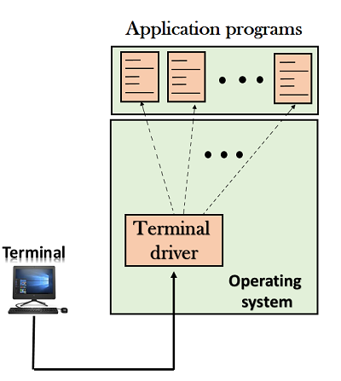
Telnet

Slide 59
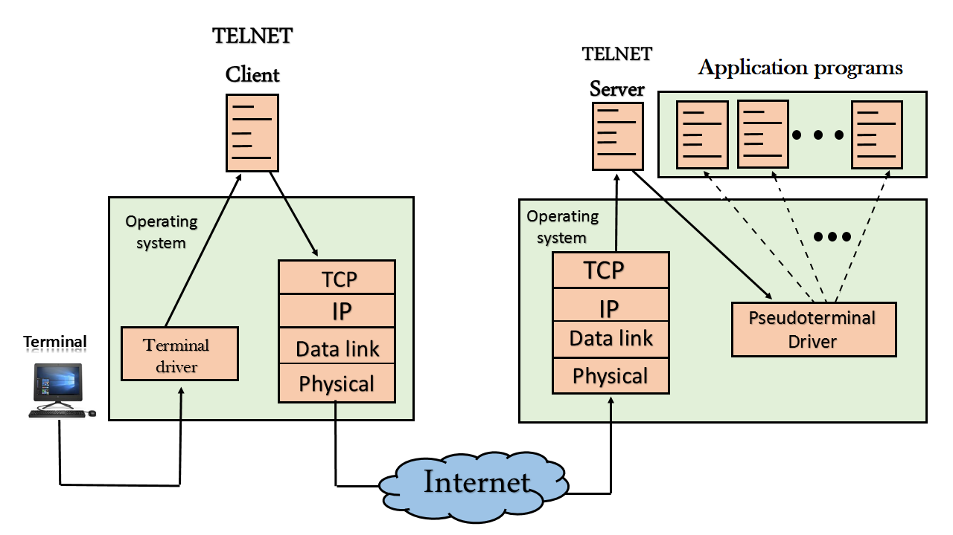
Telnet
Remote login: When the user wants to access an application program on a remote computer, then the user must perform remote login.

Slide 60
Telnet
How remote login occurs
At the local site
The user sends the keystrokes to the terminal driver, the characters are then sent to the TELNET client. The TELNET client which in turn, transforms the characters to a universal character set known as network virtual terminal characters and delivers them to the local TCP/IP stack.
At the remote site
The commands in NVT forms are transmitted to the TCP/IP at the remote machine. Here, the characters are delivered to the operating system and then pass to the TELNET server.
The TELNET server transforms the characters which can be understandable by a remote computer. However, the characters cannot be directly passed to the operating system as a remote operating system does not receive the characters from the TELNET server.
Therefore it requires some piece of software that can accept the characters from the TELNET server. The operating system then passes these characters to the appropriate application program.

Slide 61
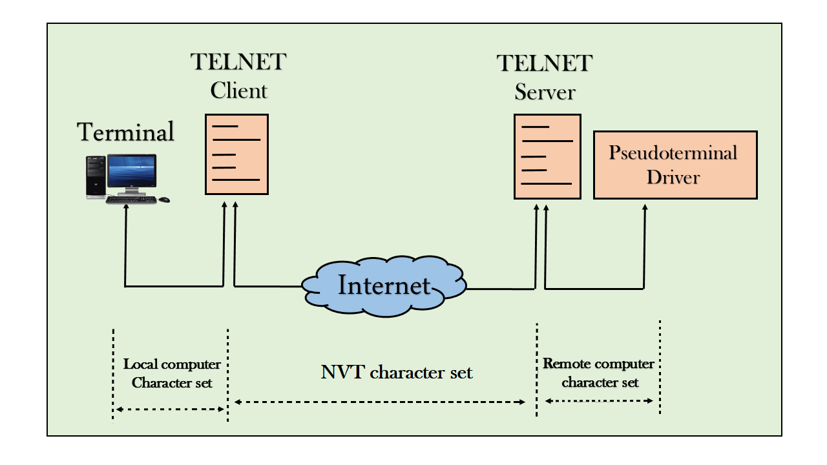
Telnet
Network Virtual Terminal (NVT)

Slide 62
Telnet
The network virtual terminal is an interface that defines how data and commands are sent across the network.
In today's world, systems are heterogeneous. Ex: the operating system accepts a special combination of characters such as end-of-file token running a DOS operating system ctrl+z while the token running a UNIX operating system is ctrl+d.
TELNET solves this issue by defining a universal interface known as network virtual interface.
The TELNET client translates the characters that come from the local terminal into NVT form and then delivers them to the network. The Telnet server then translates the data from NVT form into a form which can be understandable by a remote computer.

